Slide 1
AWS Retail ETL Pipeline
Presented By:
Gokul G
Nivetha M P

Slide 2
Project Overview
This project implements an automated AWS Retail ETL pipeline that processes retail sales data from Amazon S3 to Amazon Redshift. When a CSV file is uploaded, AWS Lambda validates the file and triggers AWS Glue jobs to clean and transform the data into a star schema dataset. The transformed data is then loaded into an Amazon Redshift data warehouse using SQL scripts. Finally, the processed data is archived, temporary files are cleaned up, and execution logs are maintained. The solution leverages AWS managed services to build a scalable, reliable, and automated data pipeline that ensures data quality and supports efficient analytics.

Slide 3
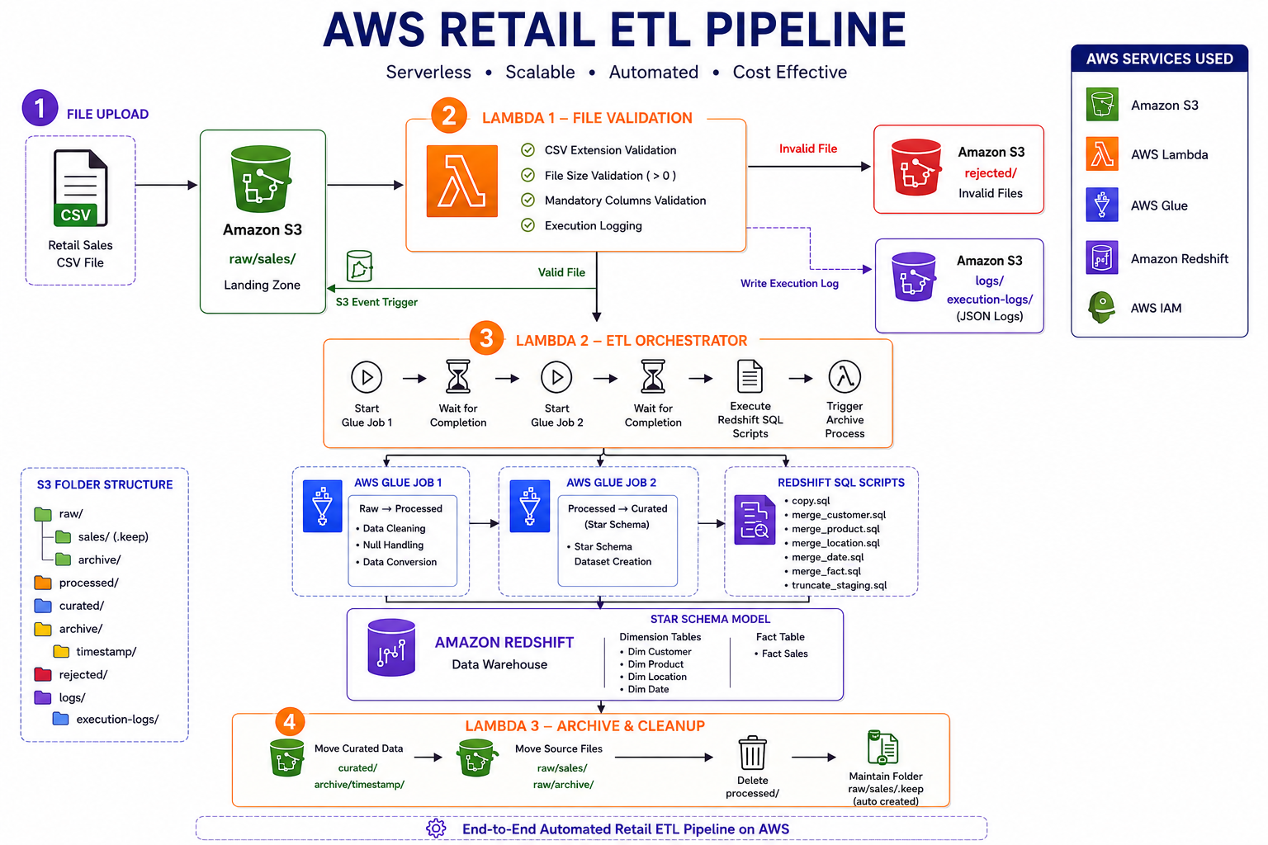
Architecture Diagram

Slide 4
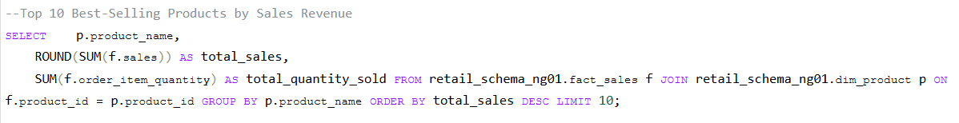
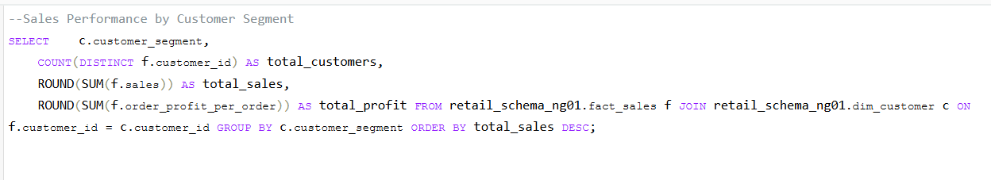
Use Cases

Slide 5
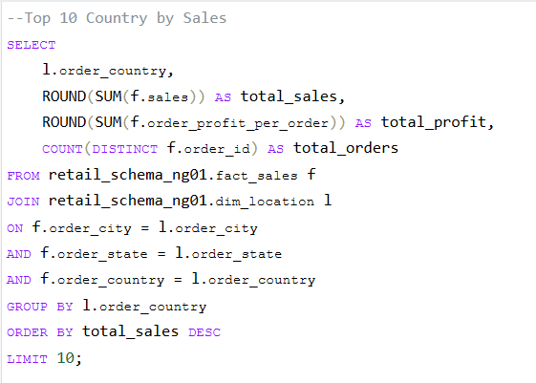
Use Cases

Slide 6
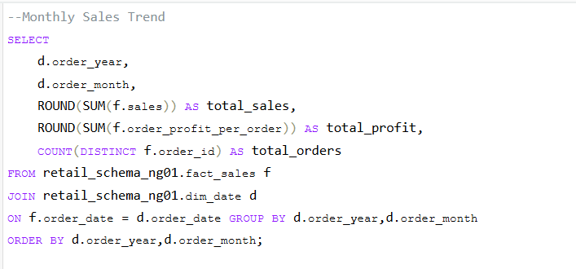
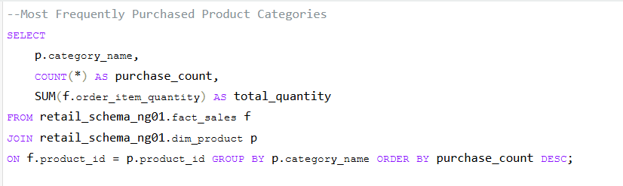
Use Cases

